Slide 1
TITLE:
MOBILE APP DEVELOPMENT PROCESS
CEF 440, Internet programming and Mobile Programming
Requirement Analysis Phase
Lecturer: Dr Valery Nkemeni
Report by Group 21
S/N | NAME | Specialisation | Matricule
1 | CHE RANDY FANG | Software | FE23A030
2 | ECHUNDIP CARL-LAWRENCE N. | Networking | FE23A040
3 | MAKANE THANKS MOSAKA | Software | FE23A085
4 | NUMFOR PRECIOUS LUM | Software | FE23A126
5 | TEMFA NKOMBONG FORTUNEE | Software | FE23A168

Slide 2

Introduction
Requirement analysis ensures proposed system requirements are complete, clear, achievable, and aligned with user expectations.
Context
Process
Learners in Cameroon face high data costs, volatile connectivity, and varying digital literacy.
Review → Identify ambiguities → Prioritize → Classify → Develop SRS → Validate
Goal
Inclusive, adaptive digital education for low-resource environments.

Slide 3

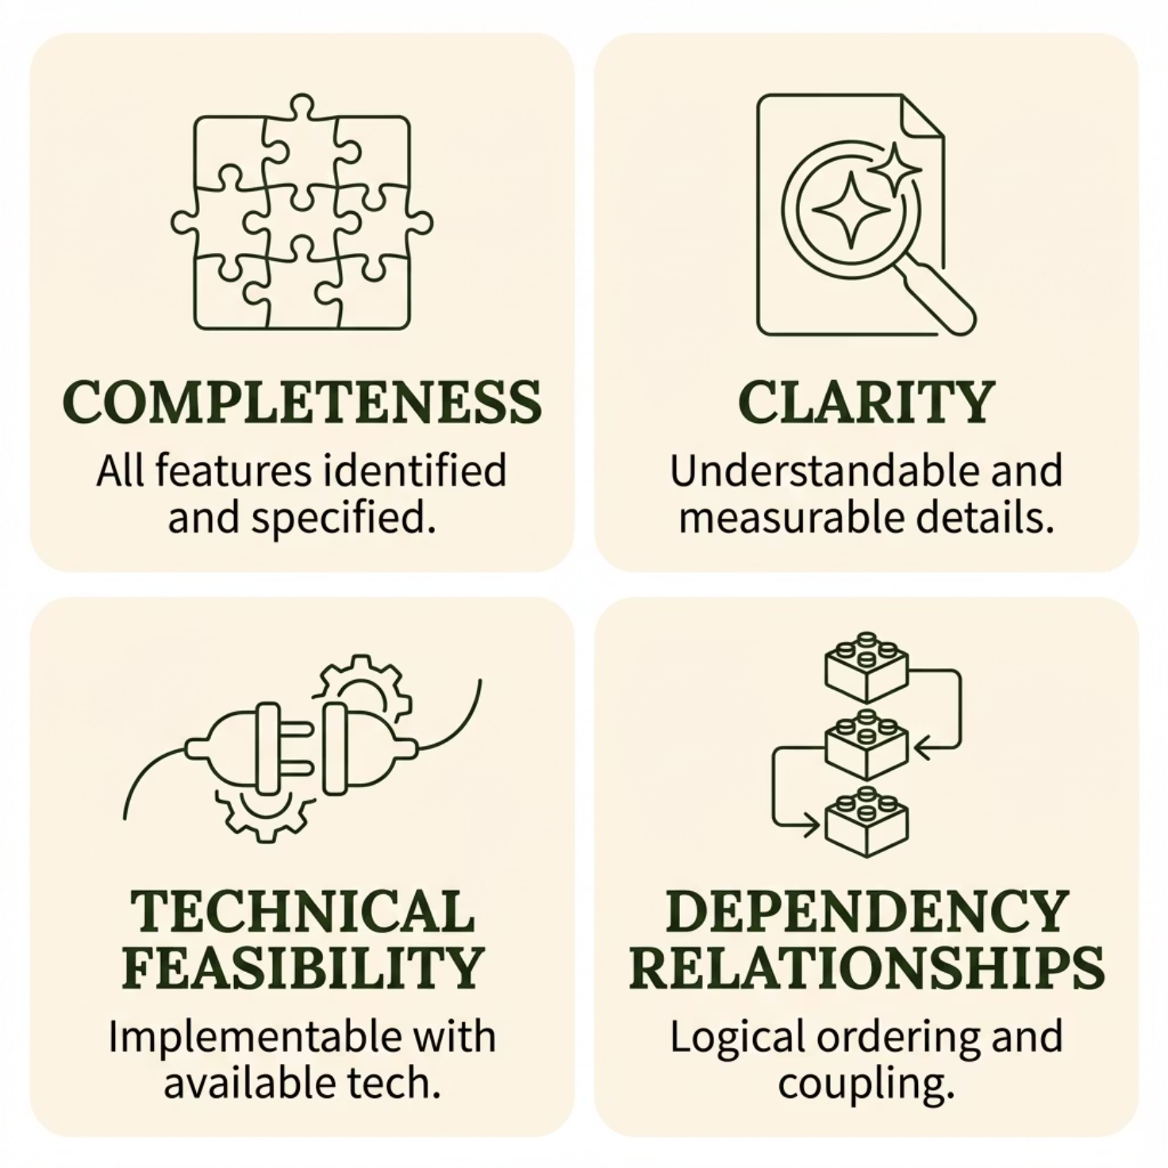
Requirement Review & Analysis
Requirements examined across four dimensions:
The requirements gathered through surveys, interviews, brainstorming, and reverse engineering are subject to rigorous examination across four dimensions

Slide 4
Completeness Analysis

Slide 5
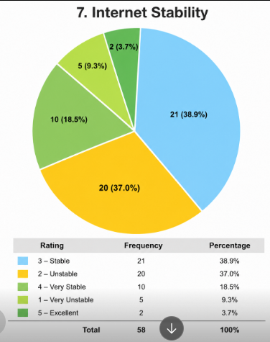
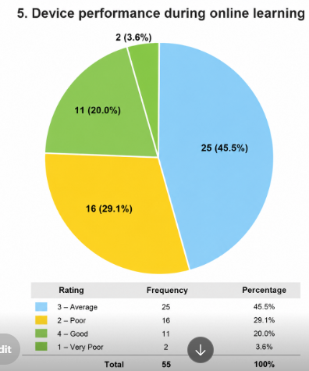
Data Analysis (Quantitative)
Device performance during online learning
Internet stability

Slide 6
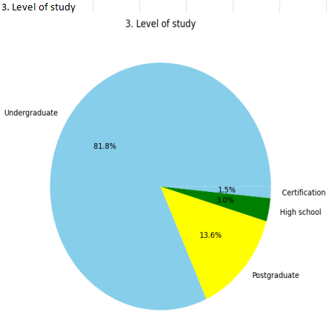
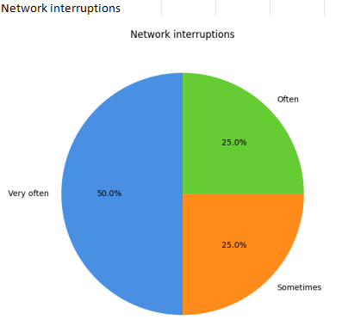
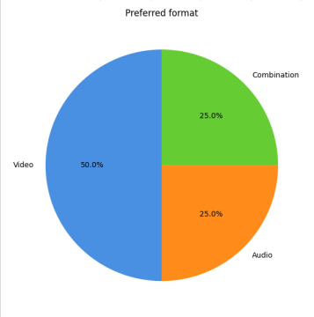
For Qualitative

Slide 7
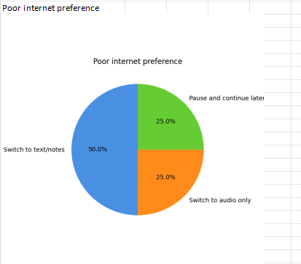
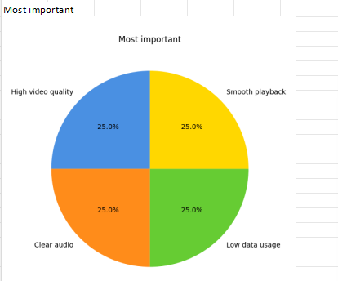
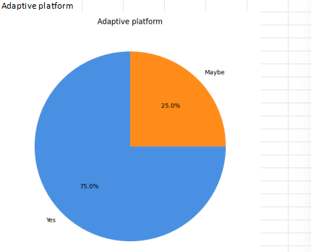

Slide 8

Data Analysis: Survey Findings
Device Performance
Internet Stability
Average performance across devices during online learning.
Connectivity rated as averagely stable; interruptions occur very often.
Content Preference
Platform Preference
Most learners prefer video for online studying.
High majority prefer an adaptive platform over an inflexible one.
Respondents were predominantly undergraduates. All desired smooth playback, low data usage, high video quality, and clear audio.

Slide 9
Clarity & Feasibility Analysis
Vague → Clear Requirements
Technical Feasibility
Original
Clarified
Feature
Feasibility
System should improve learning
Dynamically adapt content: video → audio → text based on real-time bandwidth
User authentication
High
Course content delivery
High
Platform should reduce interruptions
Auto-switch to audio-only when bandwidth falls below threshold
Real-time live adaptation
Moderate
Offline sync
Moderate
AI recommendations
Future upgrade
App should be easy to use
Any primary function reachable within 3 taps; first-time user navigates in 5 min

Slide 10

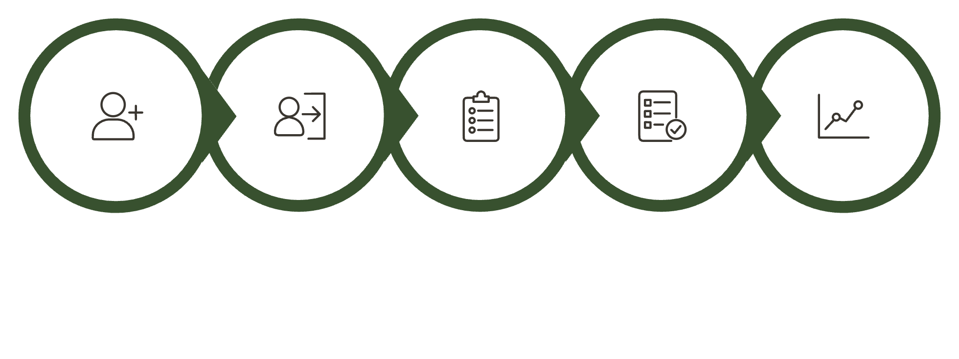
Dependency Relationships
Features cannot function without prior capabilities. Development must follow logical order.
Register
Login
Enroll
Quizzes
Progress
Uploading materials depends on lecturer authentication. Certificate generation depends on course completion.

Slide 11
Inconsistencies, Ambiguities & Missing Info
Inconsistency
Ambiguities Resolved
Missing Requirements Added
Students wanted unrestricted access
lecturers/admins preferred controlled enrollment.
Resolution: Admins manage enrollment permissions.
"Work well" → stable under low-bandwidth.
"Easy to navigate" → intuitive mobile-friendly menus.
"Support online learning" → video, quizzes, downloads, assignments.
Password recovery · Notification management · Course search ·
Accessibility support ·
Backup & recovery ·
User profile editing

Slide 12

Requirement Prioritization
🔴 High
🟡 Medium
🟢 Low
Registration & login · Course management · Quiz system · Progress tracking · Mobile responsiveness
Notification system · Offline learning · Discussion forums
AI recommendations · Dark mode

Slide 13


Requirement Classification
Functional
Non-Functional
User authentication & role management
Course content access & Management
Adaptive content delivery (3 resolution tiers)
Live lecture support
Student Progress & analytics
System Administration
Performance
Reliability and Availability
Usability and Accessibility
Security
Efficiency
Scalability and Maintainability

Slide 14


Validation & Conclusion
Stakeholders — students and lecturers — confirmed requirements address major challenges of online education in low-resource settings.
Outcome
Structured, implementable SRS ready for system design & development.
Foundation
Platform aligned with educational realities and tech limitations of low-resource environments.
The analysis ensures feasibility, accessibility, and effectiveness of the proposed adaptive e-learning solution.

